Slide 1
Excel Advanced
Session 1

Slide 2
Excel Window
Ribbon
Name box
Formula bar
Status bar
Formatting

Slide 3

Ribbon
Menu bar

Slide 4

Namebox

Slide 5
Formula bar

Slide 6
Status Bar

Slide 7
Formatting
Cells
Rows & Col
Sheet

Slide 8
Basic Functions
SUM
MAX
MIN
AVERAGE
COUNT

Slide 9
Basic Functions
Cell Reference
Range
Absolute Reference

Slide 10

IF Function
IF(B2>50,”Pass”,”Fail”)

Slide 11

IFs Function
IFS(A2>89,"A",A2>79,"B",A2>69,"C",A2>59,"D",TRUE,"F")

Slide 12
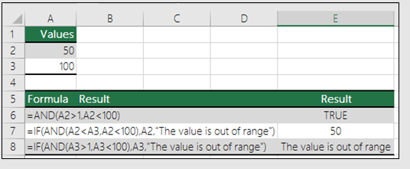
AND Function

Slide 13
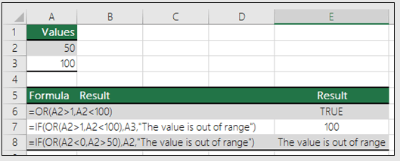
OR Function

Slide 14
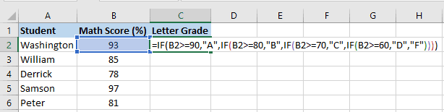
Nested IF

Slide 15
SUMIF
Numeric Criteria
Text Criteria
Date Criteria
And Criteria
Or Criteria

Slide 16
Thank you
Brain Station
Eng. Dalia Khamiss

